Slide 1







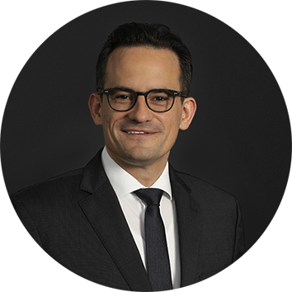


SAVE THE DATE - WEBINAR Navigating Upcoming Changes in European Employment Law
Join our upcoming webinar, organised in collaboration with ACC Israel, to discover the latest developments in employment law across France, Germany, Italy and the Netherlands. Our international experts will discuss forthcoming changes, including the Pay Transparency Directive, the impact of AI in the workplace, and legal considerations around reorganisations. Don’t miss this opportunity to gain valuable insights into how these updates may affect your organisation..
18 May 2026 14 h.- 15 h. (IST)
Opening
Moderator
Noa Rosenberg Segalovitz CLO Lightricks Head of International Labor Law, ACC Israel
Ariel Nachman
Partner and Head of Israel Simmons & Simmons
Speakers
Claire Le Touzé Of Counsel, France
Sascha Morgenroth Partner, Germany
Davide Sportelli Partner, Italy
Annemarie Elenbaas Partner, The Netherlands

